Slide 1
Why Learn Computation?
Alexis Black Pyrkosz
SROP Comp Workshop: Day 0

Slide 2
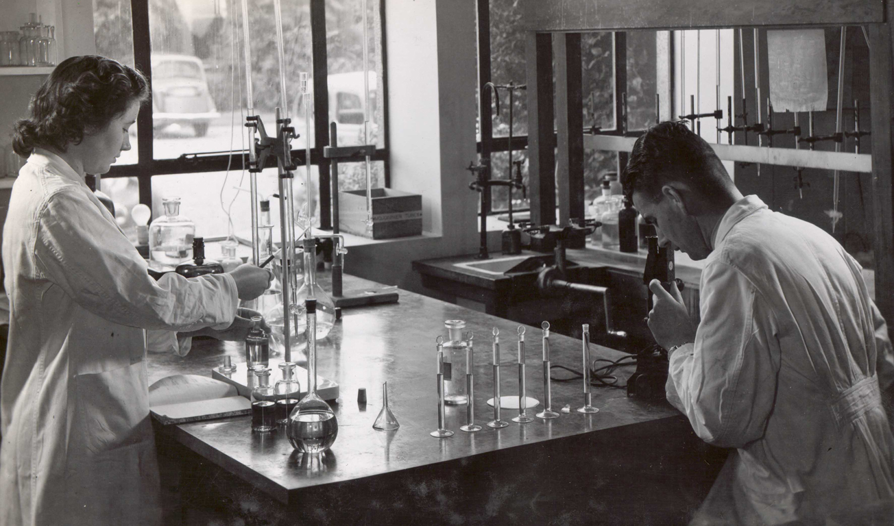
The way research was…
www.flickr.com

Slide 3
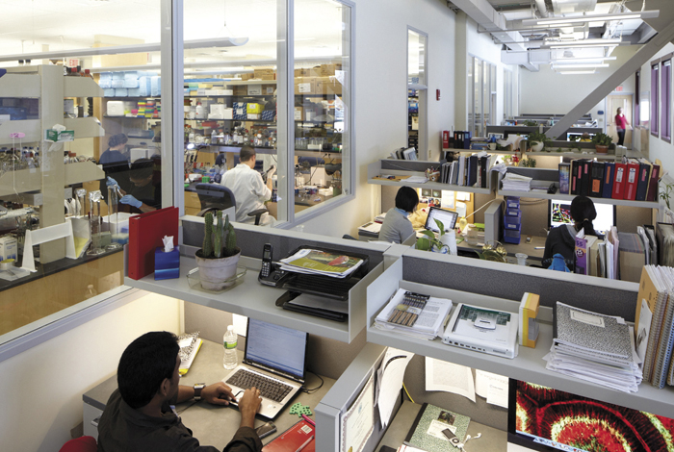
The way research is…
Today.uconn.edu

Slide 4
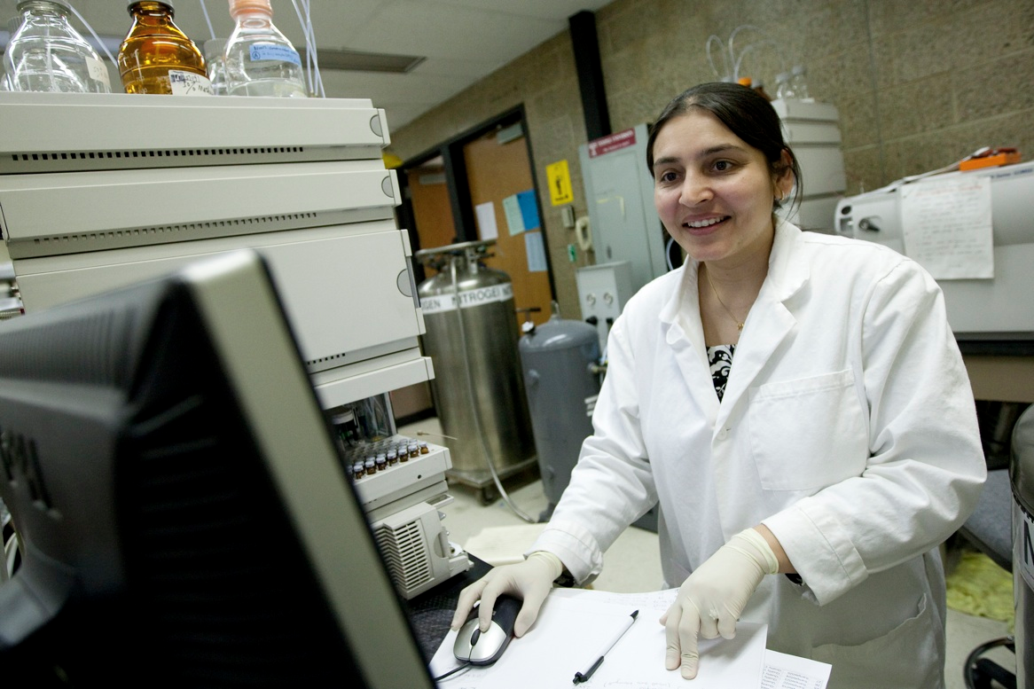
Computers are in the lab
www.temple.edu

Slide 5
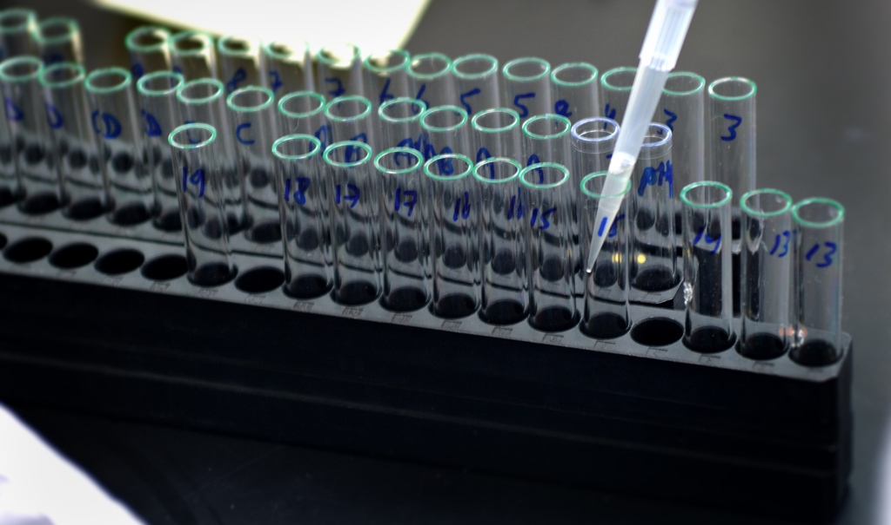
More samples, more data
www.msutoday.msu.edu

Slide 6
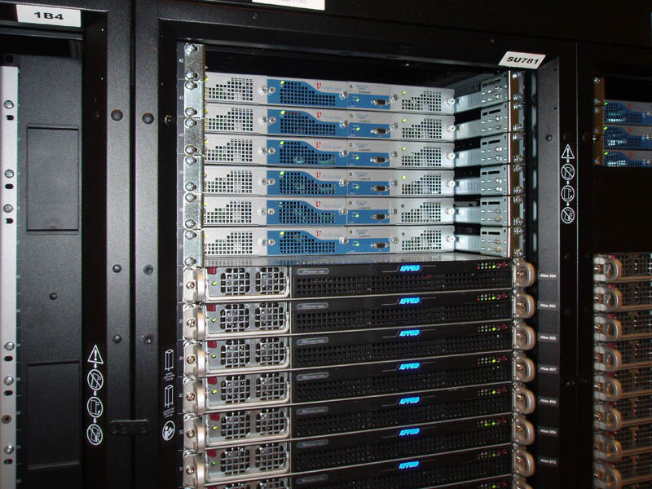
More data, more computers
Computing.llnl.gov

Slide 7
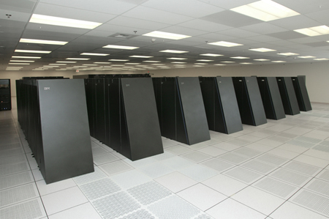
More research questions, even more computers
Computation.llnl.gov

Slide 8
Big Data
‘Big data is a collection of data sets so large and complex that it becomes difficult to process using on-hand database management tools or traditional data processing applications.
The challenges include capture, curation, storage, search, sharing, transfer, analysis, and visualization.
The trend to larger data sets is due to the additional information derivable from analysis of a single large set of related data, as compared to separate smaller sets with the same total amount of data, allowing correlations to be found.’
Wikipedia

Slide 9
Obama’s 2012 $200 million Big Data Research and Development Initiative
‘Advance state-of-the-art core technologies needed to collect, store, preserve, manage, analyze, and share huge quantities of data.
Harness these technologies to accelerate the pace of discovery in science and engineering, strengthen our national security, and transform teaching and learning.
Expand the workforce needed to develop and use Big Data technologies. ’
White House Big Data press release 3/29/2012

Slide 10


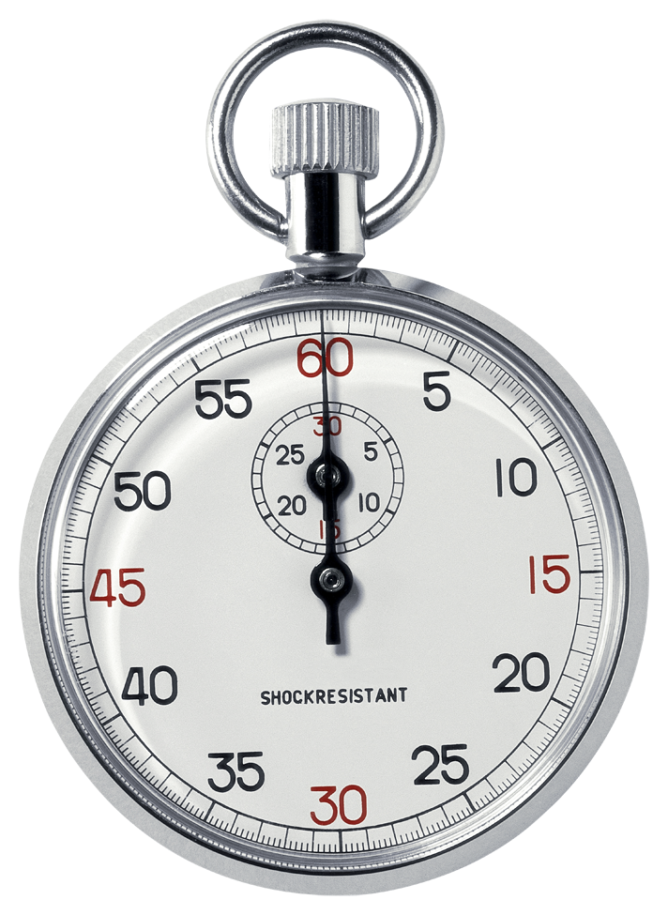
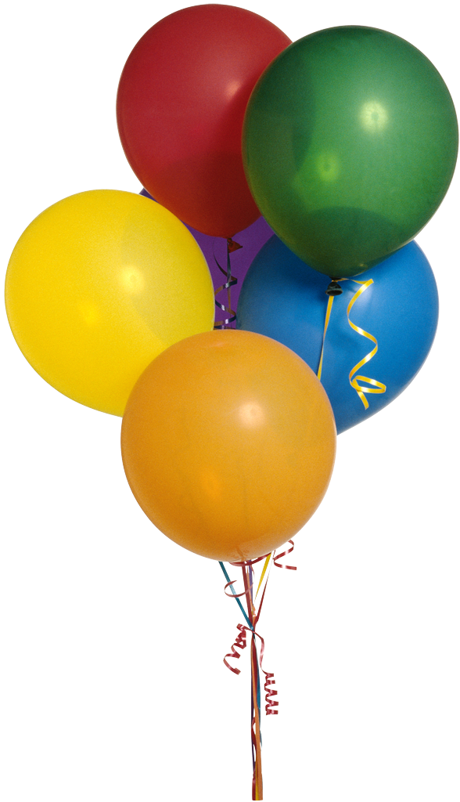
Reasons You Need to Learn Computation
Job security
Productivity
Accuracy
Creativity

Slide 11
Topics Covered
Day 0:
Introduction, Presentation Requirements
Day 1:
Intro to Hardware/Software
Intro to Command Line/Command Line Tools
Day 2:
Reproducible Research/Ipython Notebook
Version Control/Git/GitHub
Intro to the Cloud
Day 3:
Cloud Computing Long Tutorial
Day 4:
Intro to R
R in Ipython Notebook
Finish Cloud Computing Long Tutorial
Day 5:
Presentations

Slide 12
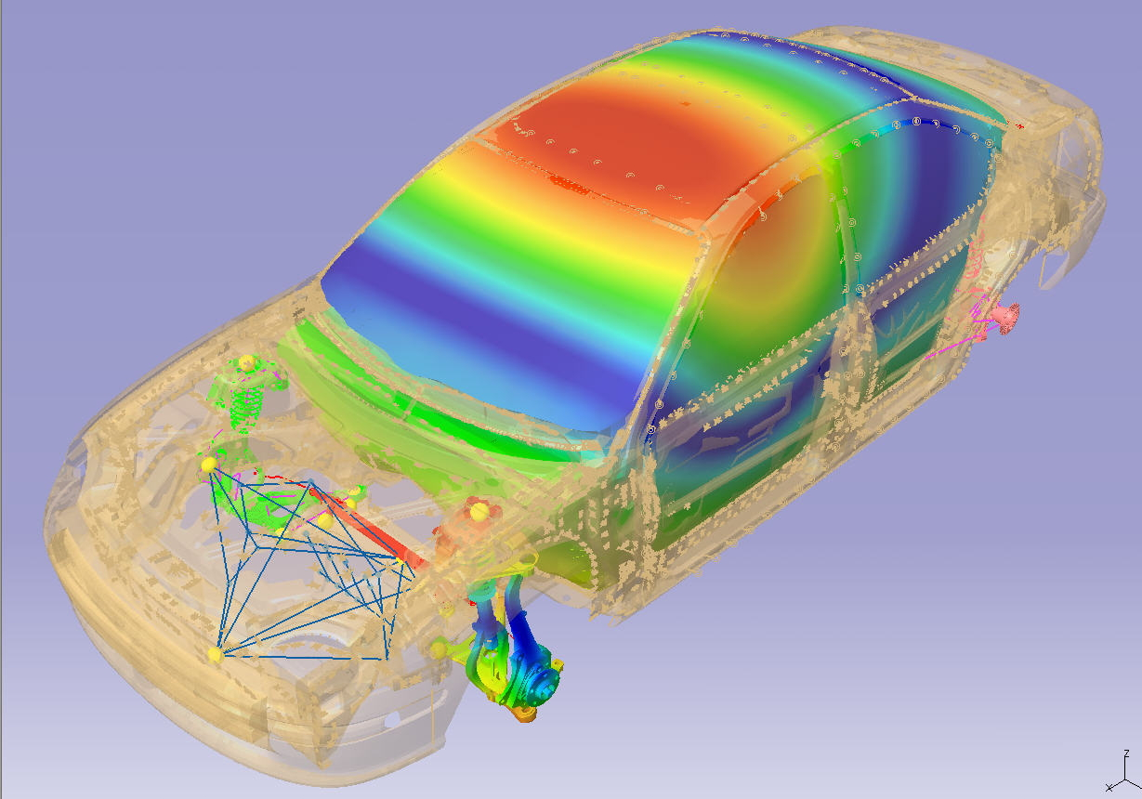
What You Can Do With computation
LMS International

Slide 13
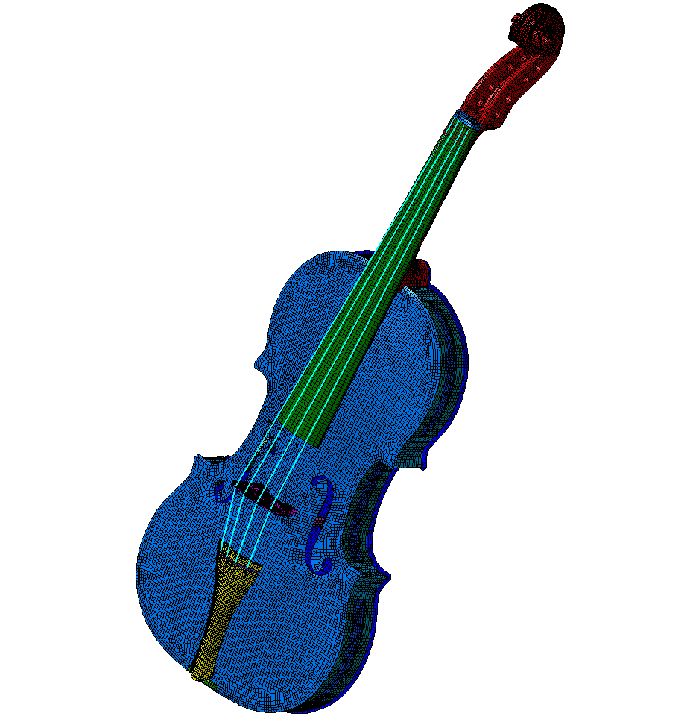
Structural Finite Element Model of a Stradivari Violin
M. Pyrkosz

Slide 14
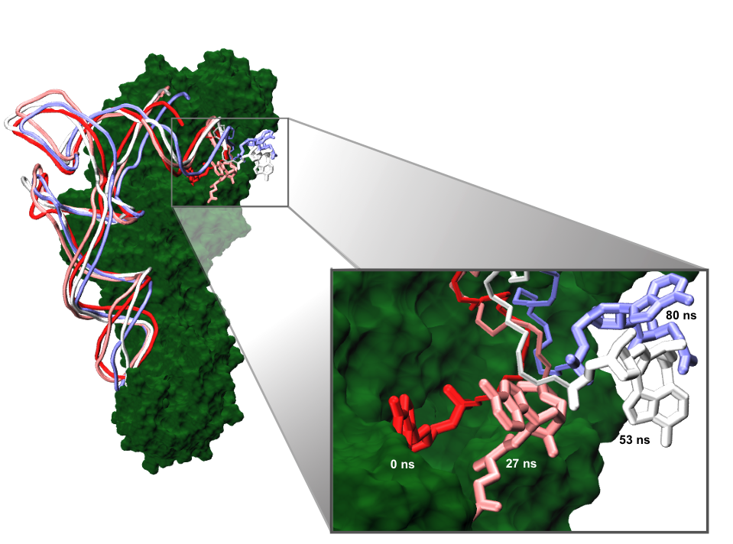
Undocking of tRNA from Aminoacyl-tRNA-synthetase
Black Pyrkosz et al. J Mol Biol (2010)

Slide 15
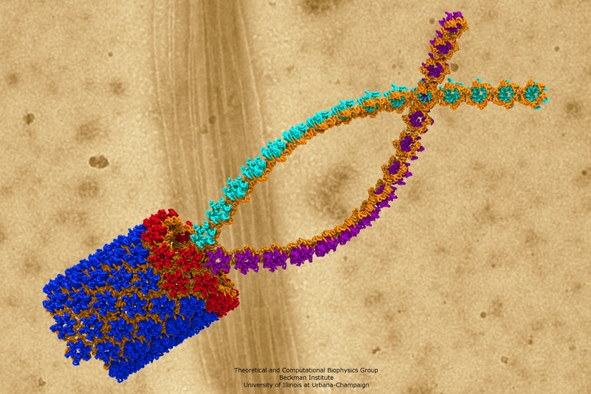
Structural Model of HIV-1 capsid
http://www.ks.uiuc.edu/Gallery/Science/viral/tn/HIV_juanp.jpg.html

Slide 16
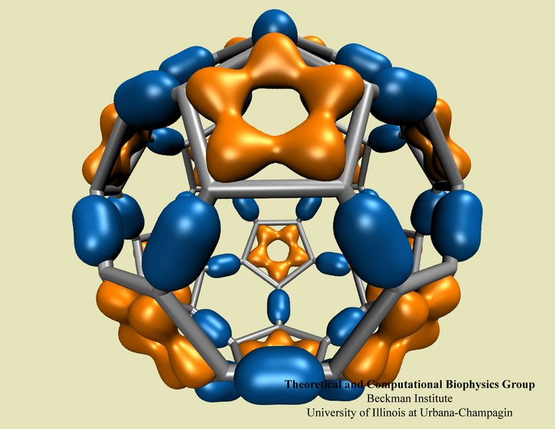
Molecular orbitals of C60 fullerene
http://www.ks.uiuc.edu/Gallery/Science/non_protein/tn/c60_orb104_beige_st.jpg.html

Slide 17
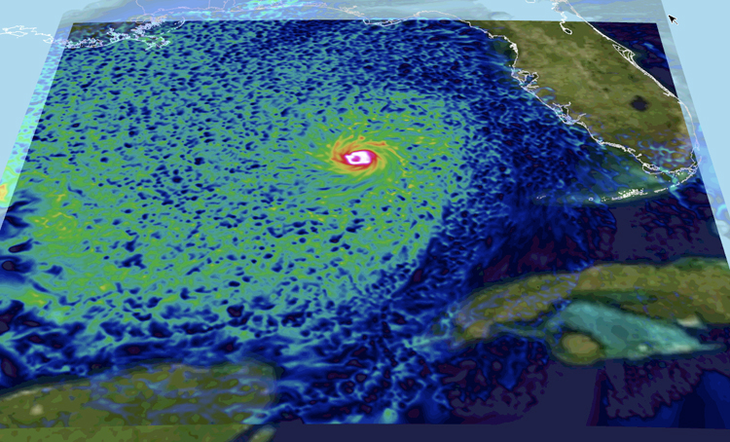
Hurricane Modeling
http://www.tacc.utexas.edu/scivis-gallery/hurricane-modeling

Slide 18
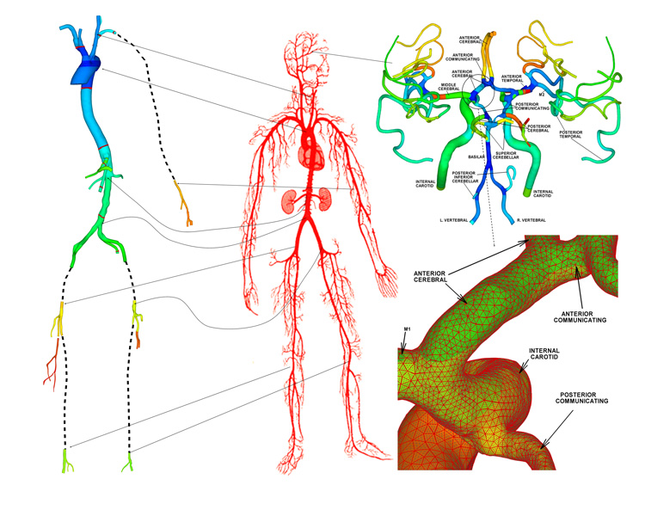
Human arterial tree
http://www.tacc.utexas.edu/scivis-gallery/arterial-tree

Slide 19
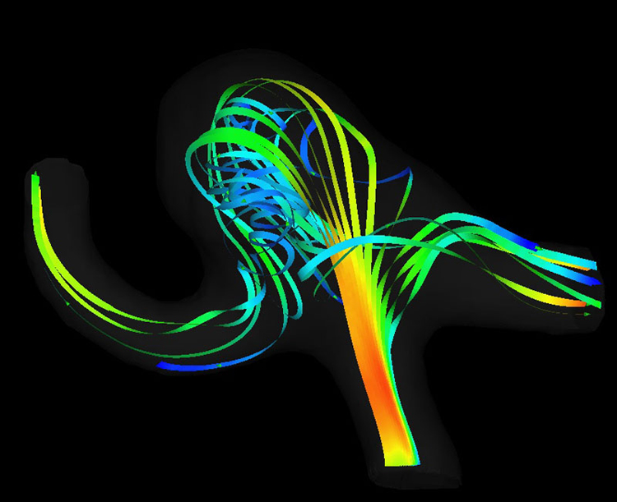
Aortic Blood Turbulence from a Pump
http://www.tacc.utexas.edu/scivis-gallery/blood-turbulence

Slide 20
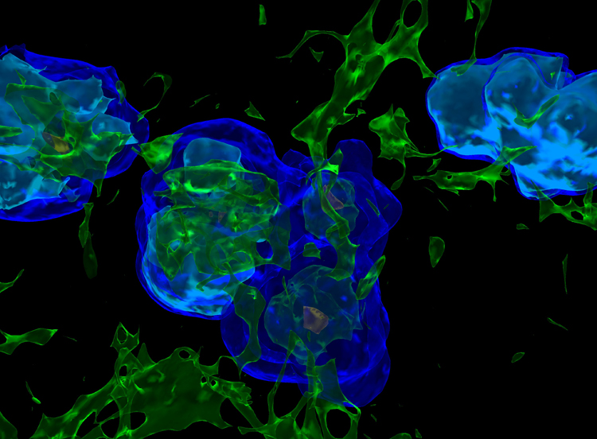
Model of the Universe 300M years after the Big Bang with radiation/gas
http://www.tacc.utexas.edu/scivis-gallery/cosmic

